Slide 1

Data Engineering – Part1
Nirav Kumar
Cloud Architect & Microsoft Certified Trainer
@niravk100

Slide 2
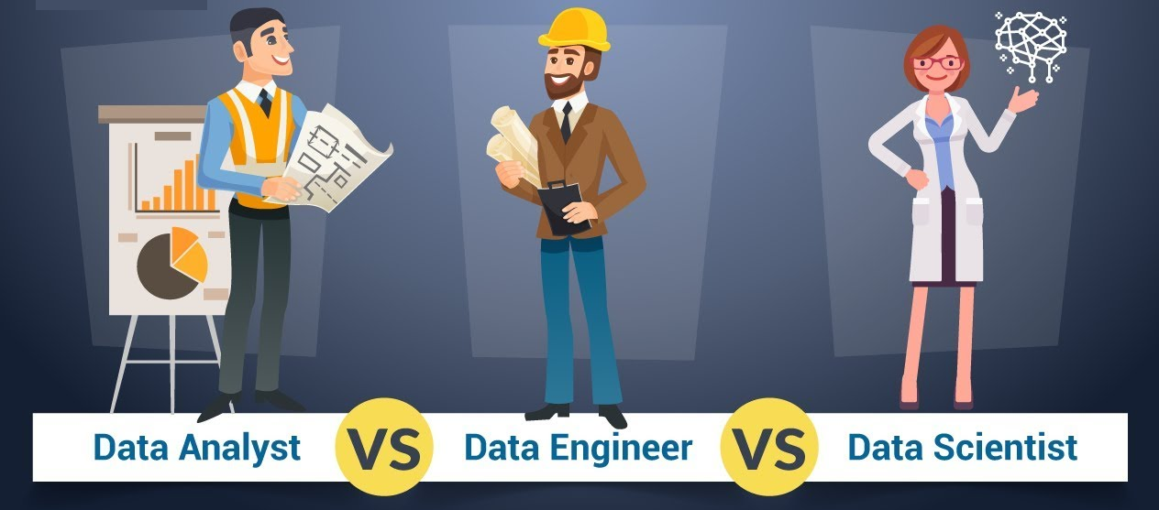

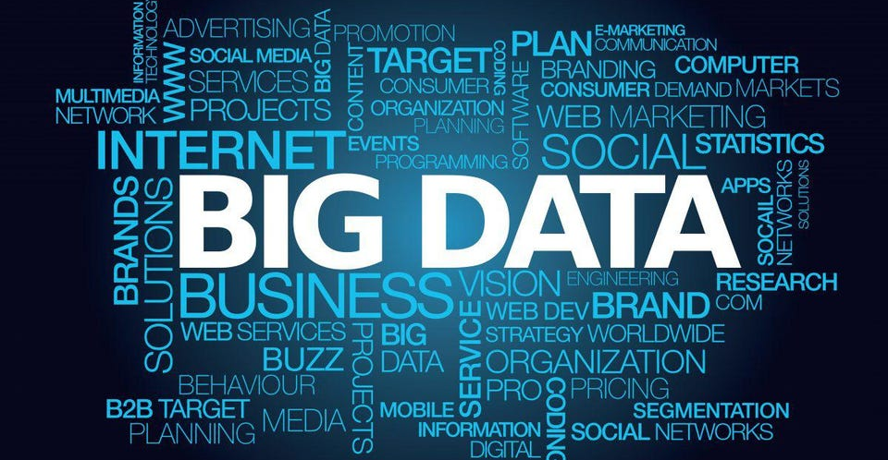
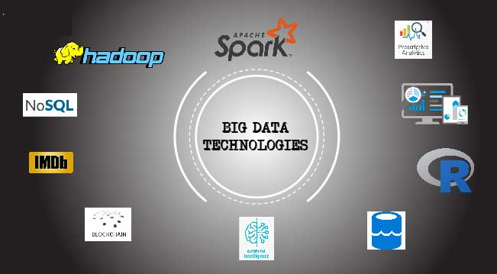

Slide 3
Overview
Introduction to Big Data
Major Big Data technologies
Azure Big Data Services
Different Roles in Big Data
What Does a Data Engineer Do and How Can You Become One?
Demo
Summary

Slide 4
You’ll be able to understand Big Data, azure big data services & the skills required to become a Data Engineer.

Slide 5
PREREQUISITES
Azure Cloud
Data Concepts
Python programming
Notes:
Before beginning this video you should have basic knowledge of Azure Cloud, data concepts and python programming

Slide 6
Introduction to Big Data?

Slide 7
Big Data
Big Data is a collection of data that is huge in volume, yet growing exponentially with time. It is data with so large size and complexity that none of the traditional data management tools can store it or process it efficiently.
Big Data Characteristics
Types of Big Data
Notes:
Big data can not be processed efficiently using traditional tools.
For example, a retail company might use Big data to analyze customer shopping habits and preferences to optimize their marketing strategies.
A healthcare organization might use Big data to study medical records and identify the most effective treatments for different conditions.
And a city government might use Big data to track traffic patterns and make improvements to public transportation.

Slide 8
Big Data Characteristics
Volume
Velocity
Variety
Notes:
Volume refers to the amount of data that is necessary to analyze and process. . Volume - 100s of TB or higher
Velocity refers to the speed at which that data may be arriving and collecting
Variety refers to the fact that the data can be structured, semi-structured, or unstructured such as audio, video, and still images.
Two more are Veracity and Value
Two more are Variability and Visualization

Slide 9




Slide 10
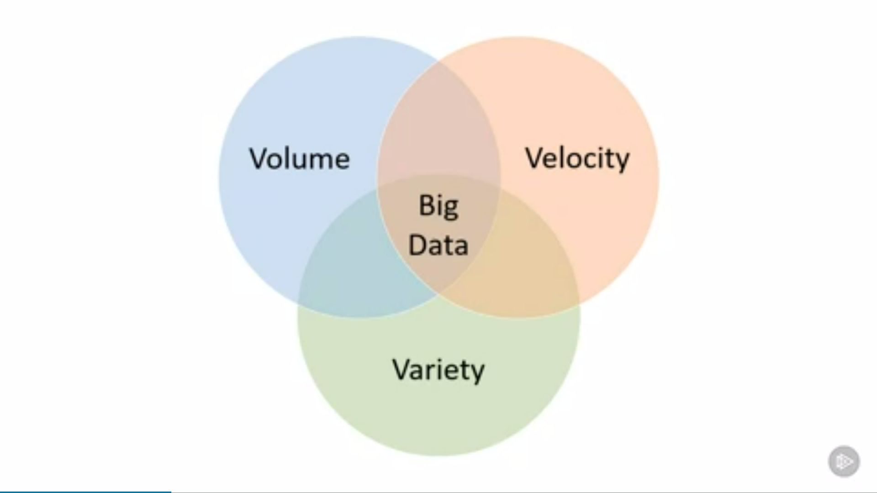

Slide 11
Type of Big Data
Structured
Semi-Structured
Unstructured

Slide 12
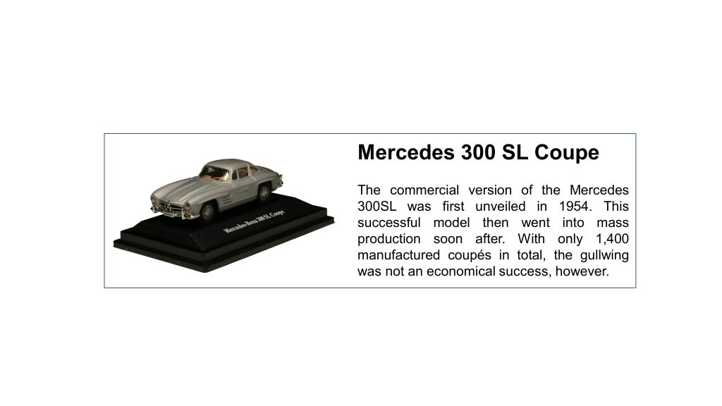
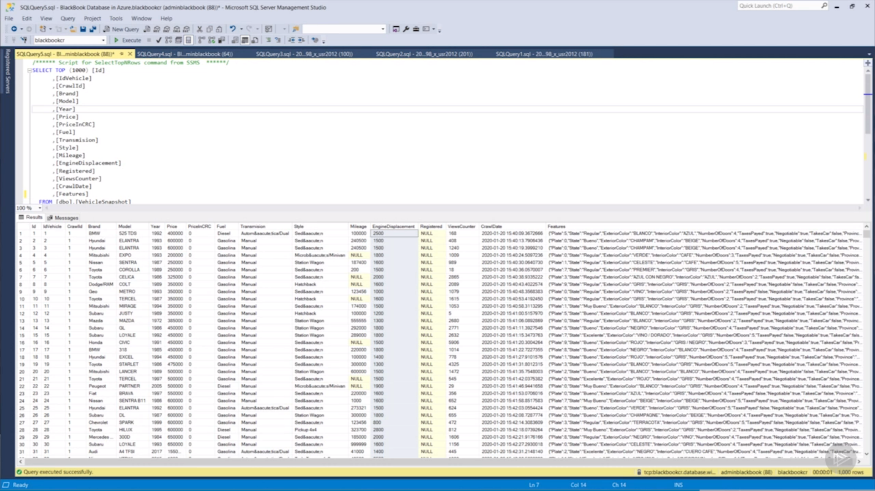
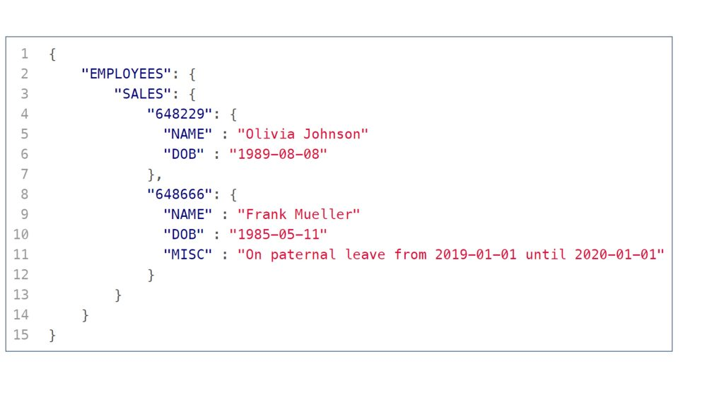
Notes:
Structured data is the data that conforms to a data model and is usually stored in well-defined schemas such as Databases. It is generally tabular with columns and rows that clearly define its attributes.
Semi-structured data is data that does not conform to a data model but has some structure. It lacks a fixed or rigid schema. It is the data that does not reside in a rational database but that have some organizational properties that make it easier to analyze. With some processes, we can store them in the relational database.
Unstructured data is information that is not arranged according to a preset data model or schema, and therefore cannot be stored in a traditional relational database or RDBMS. Text and multimedia are two common types of unstructured content.

Slide 13
Major Big Data Technologies

Slide 14
Type of Big Data Technologies
Storage Technologies
Integration Technologies
Processing Technologies
Visualization Technologies
HDFS, Azure Data Lake, AWS S3, etc
Azure Data Factory, AWS Glue, etc
Apache Hadoop, Apache Spark, Azure DataBricks, etc
Power BI, Tableau, etc
Notes:
Storage technologies: These are used to store and manage large volumes of data. Examples include Hadoop Distributed File System (HDFS), Amazon S3, and Microsoft Azure Data Lake Storage.
Processing technologies: These are used to process and analyze large amounts of data. Examples include Apache Hadoop, Apache Spark, and Apache Flink.
Visualization technologies: These are used to create visual representations of data for easier analysis and understanding. Examples include Tableau, Microsoft Power BI, and QlikView.

Slide 15
Azure Big Data Services

Slide 16
Azure Major Big Data Services
Azure Data Lake
Azure Data Factory
Azure Databricks
Notes:
Azure provides a range of Big data services, by leveraging these services, businesses can store, process, and analyze vast amounts of data in the cloud.
This allows them to gain insights into customer behavior, optimize operations, and make better decisions based on the data at hand.
Azure Data Factory is a service that can ingest large amounts of raw, unorganized data from relational and non-relational systems, and convert this data into meaningful information.
Data Factory provides a scalable and programmable ingestion engine that you can use to implement complex hybrid extract-transform-load (ETL), extract-load-transform (ELT), and data integration projects.
Azure Data Lake is a collection of analytics and storage services that you can combine to implement a big data solution.
Azure Databricks is an analytics platform optimized for the Microsoft Azure cloud services platform.
Databricks is integrated with Azure to provide oneclick setup, streamlined workflows, and an interactive workspace that enables collaboration between data scientists, data engineers, and business analysts.

Slide 17

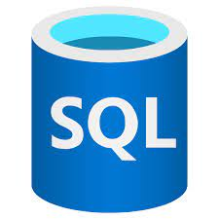

Azure Other Big Data Services
Azure Synapse
Azure SQL
Azure Stream Analytics
Notes:
Azure Synapse Analytics is an analytics service that brings together data integration, enterprise data warehousing, and big data analytics.
Azure Synapse Analytics is generalized analytics service. You can use it to read data from many sources, process this data, generate various analyses and models, and save the results.
Azure Stream Analytics is an engine for real-time analytics. It offers the possibility to perform real-time analytics on multiple streams of data from sources such as sensors, web data sources, social media, and other applications.

Slide 18
Roles in Big Data

Slide 19
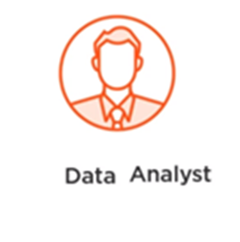


Roles in Big Data
Build Models & Run Experiments
Visualize & report data
Build Data Pipelines
Notes:
Data scientists spend a lot of time exploring, transforming, and cleaning data.

Slide 20
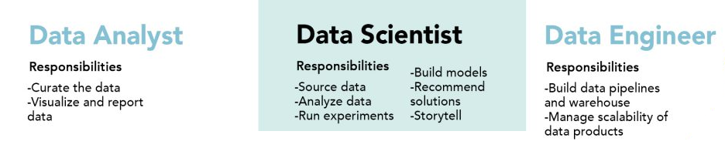
Roles in BigData

Slide 21
What Does a Data Engineer Do?

Slide 22
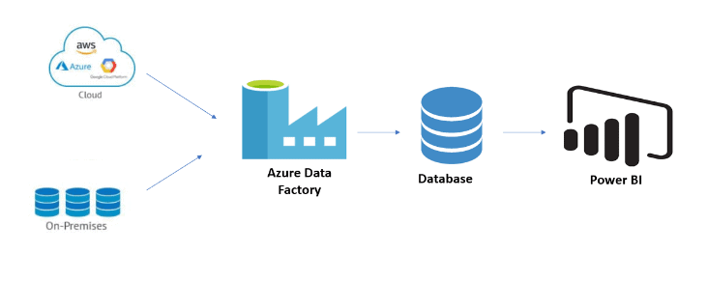
Data Engineer
The job of data engineers is to create a data pipeline to move raw data from a source system to a target database, such as a data lake or data warehouse.
Notes:
Azure data engineers are responsible for data-related implementation tasks that include ingesting raw data, transforming data, and accessing external data sources.

Slide 23
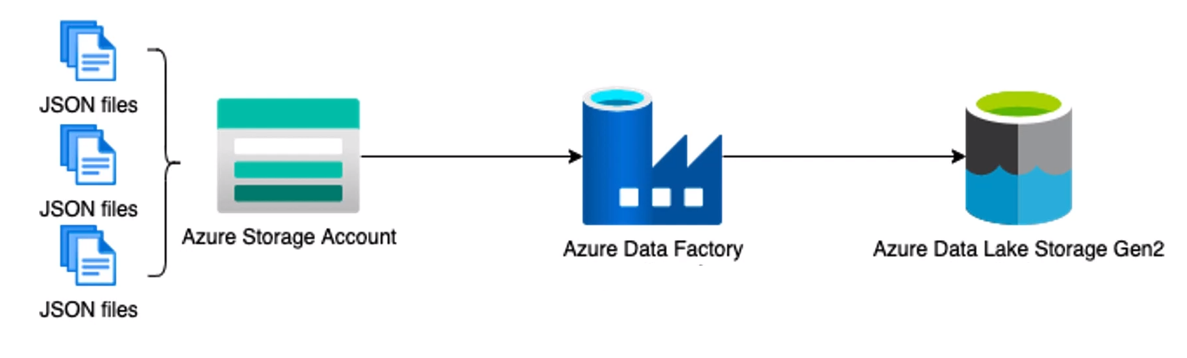
A Simple Data Pipeline

Slide 24
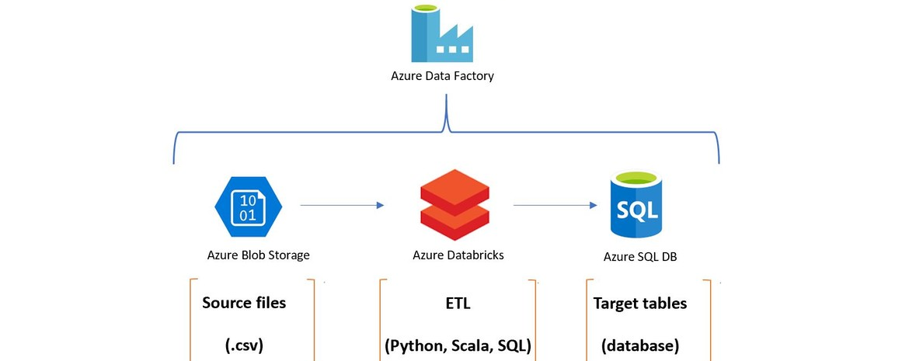
A Little Complex Data Pipeline
Notes:
ELT (extract, load, transform) and ETL (extract, transform, load) are both data integration processes that move raw data from a source system to a target database, such as a data lake or data warehouse.

Slide 25
Demo

Slide 26
Summary
Introduction to Big Data
Technologies used in Big Data
Azure Major Big Data Services
Roles in Big Data
What Does a Data Engineer Do and How Can You Become One?
Demo

Slide 27
Thanks

